Slide 1
Notes:
1 sec
Agenda:
First part NS
Second part NS+A
http://angularjs.blogspot.nl/2015/12/building-mobile-apps-with-angular-2-and.html

Slide 2


What is NativeScript?
A runtime for building and running
native iOS and Android apps
with JavaScript code base
without web views !
Notes:
Building apps without web views (= without using the Browser on your device)
8 sec – 25 sec
.

Slide 3


NativeScript Playground
Notes:
26 sec

Slide 4
https://play.nativescript.org/

Slide 5



Choice
Notes:
1.27

Slide 6
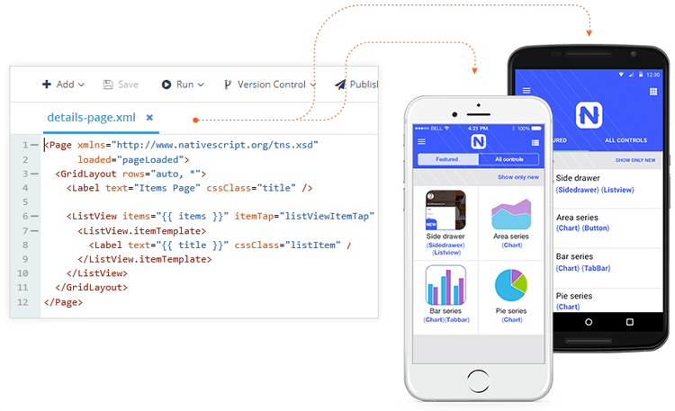
Cross Platform
iOS
Android
Notes:
32 sec
Write ones in JS, run everywhere!
SINGLE CODE BASE = JavaScript

Slide 7
Why NativeScript?
Skills reuse
Standards-based on JavaScript, CSS, TypeScript , Angular
Code reuse
NPM modules and iOS and Android libraries
Native APIs
No web views, Not Hybrid!
Open source!
Quick to learn
Notes:
45 sec
Direct access to native APIs via JavaScript → better performance !

Slide 8
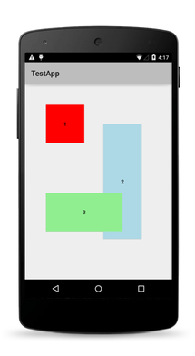
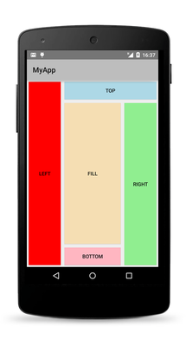
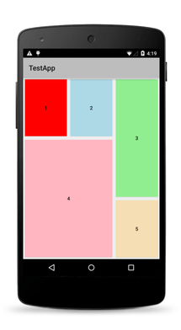
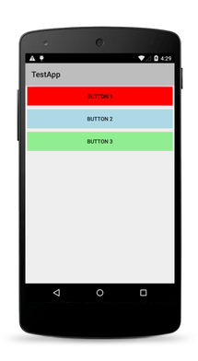
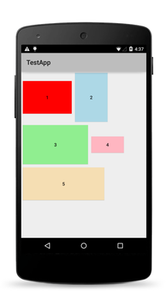
Native Layouts
Absolute
Dock
Grid
Stack
Wrap
Notes:
2.06

Slide 9
Not Ionic / Cordova
NativeScript
No browser, No DOM
Direct access to native platform APIs
NativeScript has better performance
More productive (TypeScript)
Notes:
2.19

Slide 10

Not Xamarin
NativeScript
One UI-interface for IOS/Android
No C#
Notes:
https://www.nativescript.org/blog/nativescript-and-xamarin
2.39

Slide 11
Not React Native
NativeScript
NativeScript: “write ones run everywhere!”
Use CSS for styling!
More productive (TypeScript)
Notes:
3.03

Slide 12
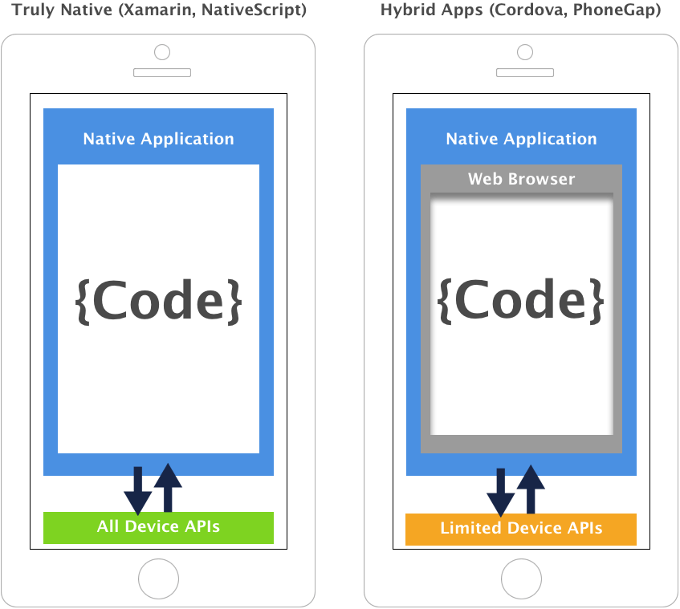
Notes:
3.46

Slide 13

Created and supported by Telerik
Notes:
I mention this because, in today’s world, where 10 JavaScript frameworks have been created since I started this presentation, that it’s important to pick an innovative and stable options
4.24

Slide 14




NativeScript modules
Code
Modules
Platform API
Notes:
Solution: NativeScript uses modules in the middle.
5.23

Slide 15
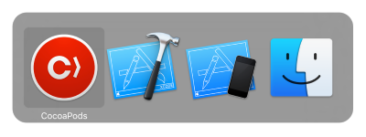


NativeScript modules
Notes:
A NativeScript plugin is any npm package that exposes a native API via JavaScript
Cocoapods = Dependency manager for Swift / ObjC
When you develop for iOS, you can quickly add third-party libraries to your NativeScript projects via the CocoaPods dependency manager.
6.04

Slide 16

Camera

Slide 17

View
<StackLayout>
<Label text="Tap the button" class="title"></Label>
<Button text="Take Photo" (tap)="onTap()"></Button>
<Image [src]="mySource"></Image>
</StackLayout>

Slide 18
CSS
Label {
color: red;
font-size: 20;
width: 200;
margin: 20;
}
Notes:
12.01

Slide 19
NativeScript Sidekick

Slide 20
Cloud build

